Slide 1
Enhancing Toronto's Resilience Against Sewer Outfall Contamination
Community-centered solutions to mitigate sewer outfall contamination and protect vulnerable communities.
Abhirami Muthukrishnan

Slide 2
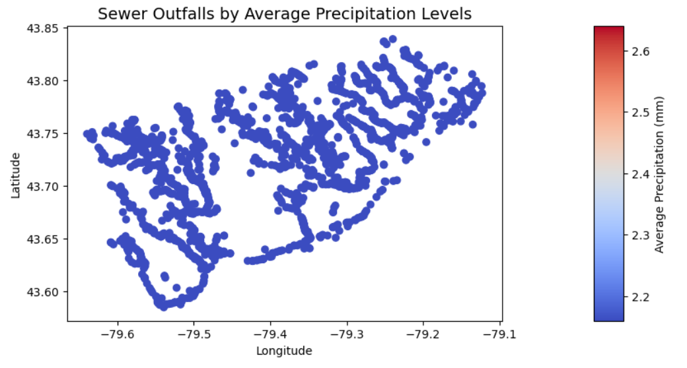
Challenge:
Toronto’s aging sewer infrastructure leads to storm-induced overflows, risking environmental and health issues for marginalized communities near sewer outfalls.
Solution
A multi-faceted, interdisciplinary approach to reducing overflow impacts:
Green Infrastructure: Soil improvements, vegetation, and steep-site constructions.
Early-Warning Systems: Real-time alerts for storm-induced overflow events.
Community Preparedness: Resources and education tailored to resident needs.
Vision Statement
Promoting environmental justice by prioritizing infrastructure and resilience in marginalized communities, empowering residents for safer, healthier living.
Community Engagement
Inclusive Partnerships: Engaging local leaders and advocates for culturally relevant solutions.
Participatory Planning: Residents co-designing response kits, infrastructure plans, and education.
Implementation Plan
Green Infrastructure Development: Partnering with non-profits and the government to install sustainable infrastructure.
Health Services Deployment: Mobile health support for immediate risk mitigation.
Interdisciplinary Collaboration
Integrating environmental science, engineering, public health, urban planning, and community organizing for a holistic, justice-centered response.

